Slide 1
Year 10 Work Experience 2025

Slide 2
When?
You will ALL be taking part in a week of work experience at the start of Term 6
Monday 9 June – Friday 13 June 2025

Slide 3
Why?
Work experience:
provides you with an insight to the world of work
allows you to develop your work-related skills
helps you to decide what you want (or don’t want) to do post 16
helps you gain confidence and independence
has often led to students gaining a part-time job
gives you practice at writing application letters and interviews

Slide 4
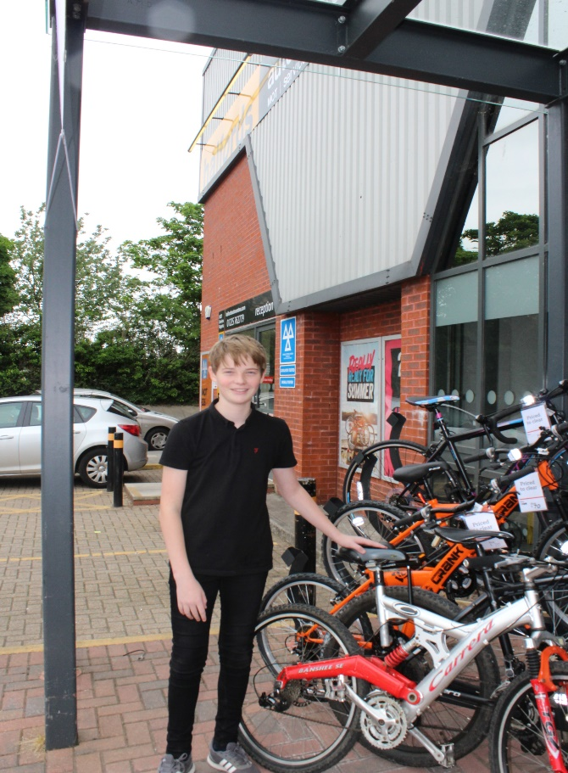
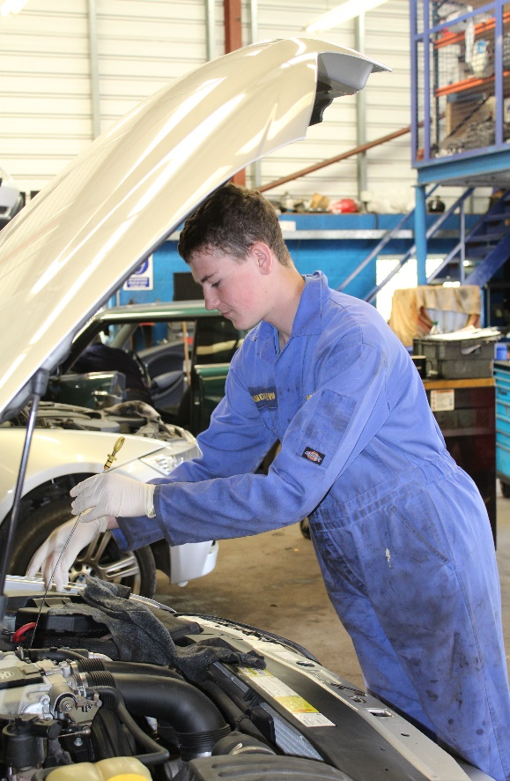
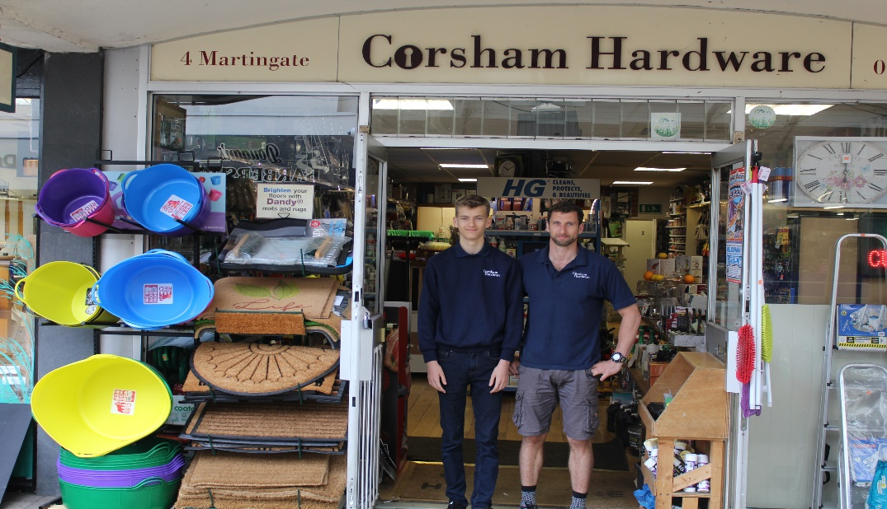
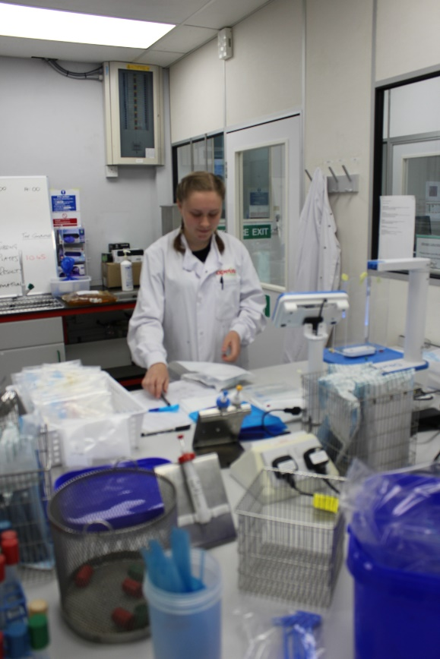
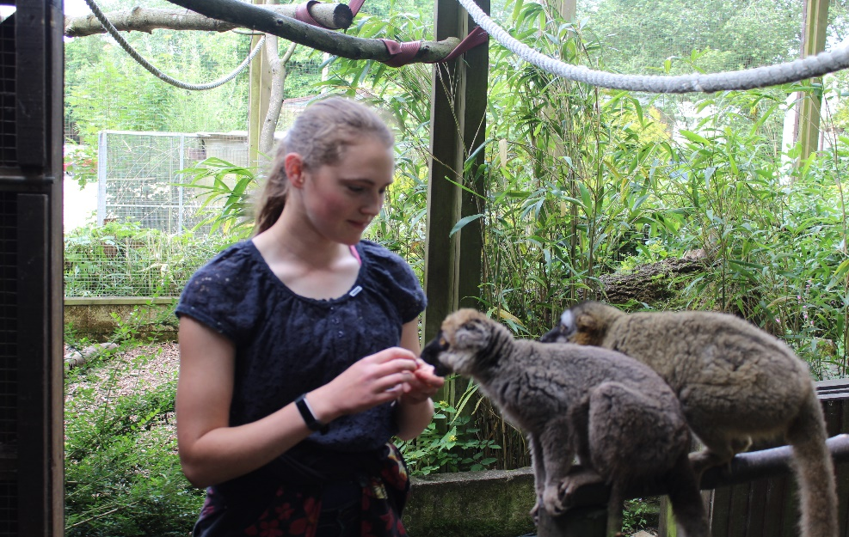
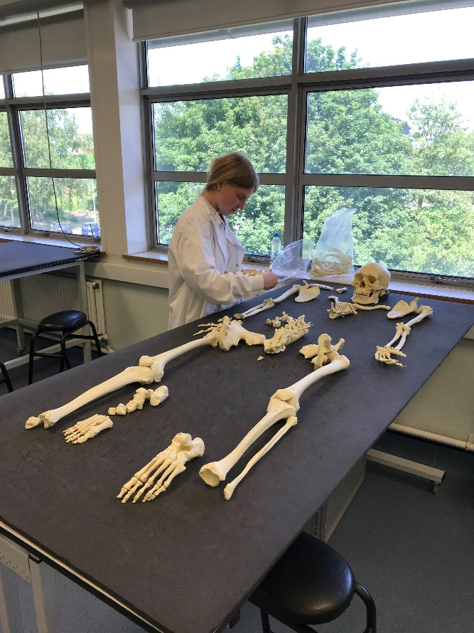

Slide 5
How?
You must arrange your work experience – it’s part of the ‘employability skills’ experience:
talk to friends and family
get in touch with local employers
apply for one of the work experience placements online
But we can help you…… ☺

Slide 6
Things to consider
How will I get there?
What will I need to wear?
How will I decide where to go?
Is it something I’m really interested in?
What do I want to get out of this week?
What skills do I want to use/ develop?

Slide 7
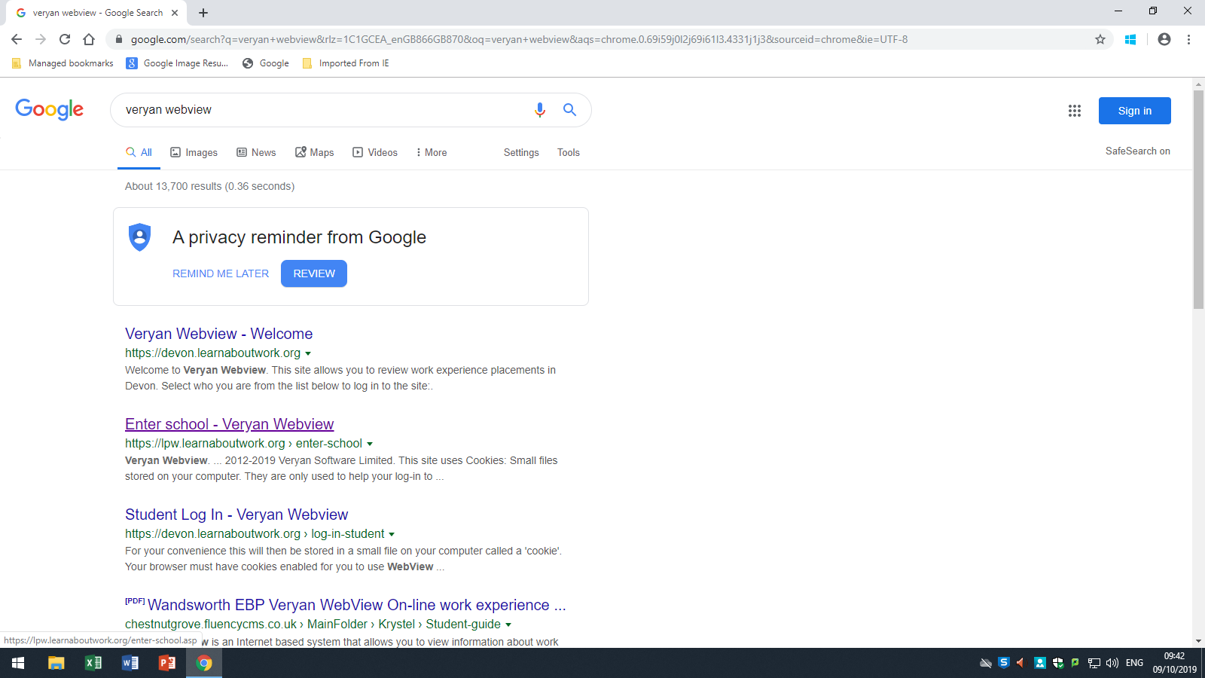
Click
‘Enter School’

Slide 8
Searching the Database

Slide 13
In PSHE you will be given guidance on how to write a formal letter/email and make a formal telephone call to employers. You can also talk to your tutors, sixth formers in your tutor group or parents to proofread your letter for you.

Slide 14
Work Experience Agreement Form (Yellow Form)
Fill in your details
Ask your employer to fill in their details
You and your parents sign
Ask your employer to sign

Slide 16
Signed Work Experience Agreement Form and Health Declaration Form should be handed into the Careers Office in the ILC
Deadline:
1st March 2024

Slide 17
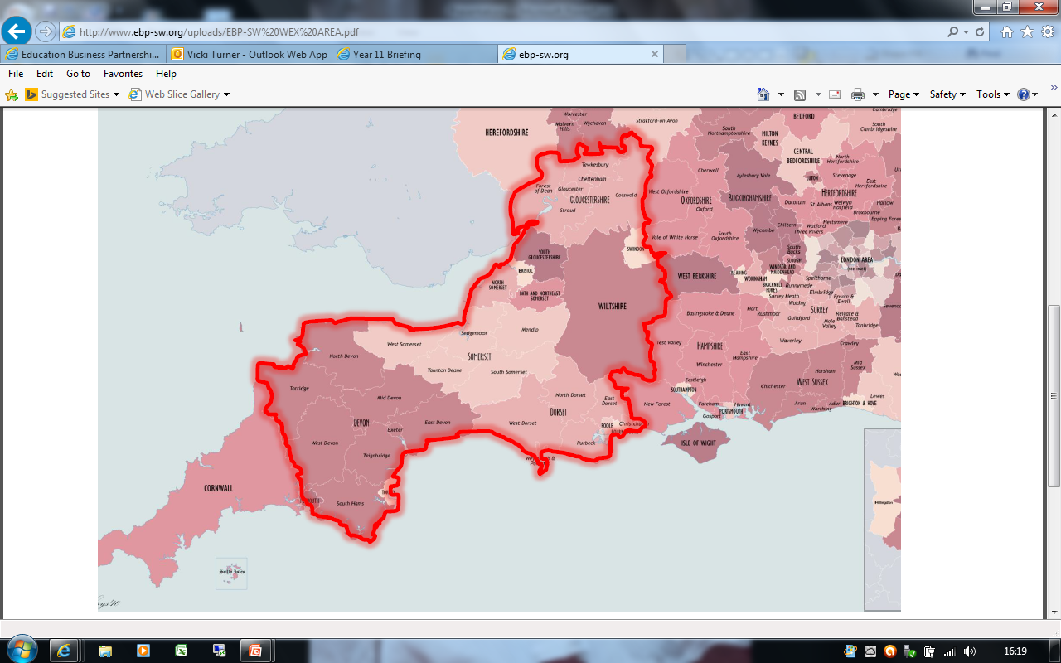
Outside of area
If you are intending to organise a placement outside of this geographical area, you must aim to get your form in before the deadline.

Slide 18
Put these dates into your diaries and phones. Late entries mean that you will need to pay the £40 admin fee.

Slide 19
Good luck! Please talk to us in Careers early if you experience difficulties – we are here to help!

