Slide 1
Year 10 Work Experience 2022

Slide 2
When?
You will ALL be taking part in a week of work experience at the start of Term 6
Monday 6 June – Friday 10 June 2022

Slide 3
Why?
Work experience:
provides you with an insight to the world of work
allows you to develop your work-related skills
helps you to decide what you want (or don’t want)to do post 16
helps you gain confidence and independence
has often led to students gaining a part-time job
gives you practice at writing application letters and interviews

Slide 4
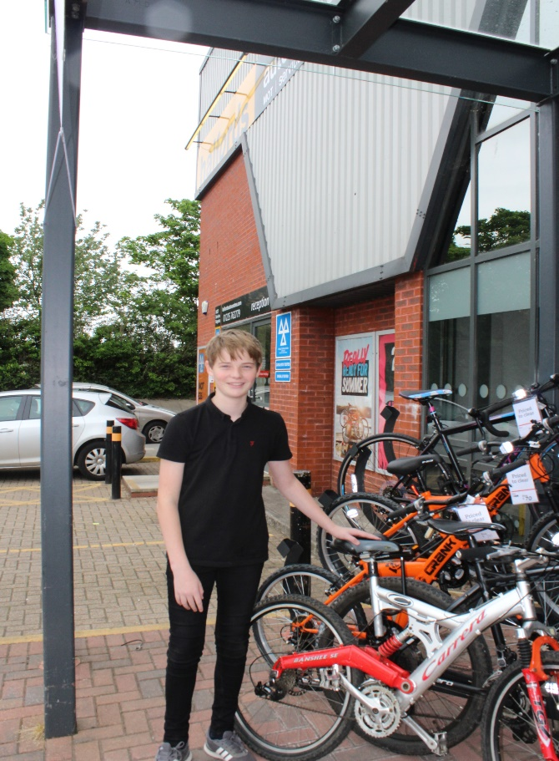
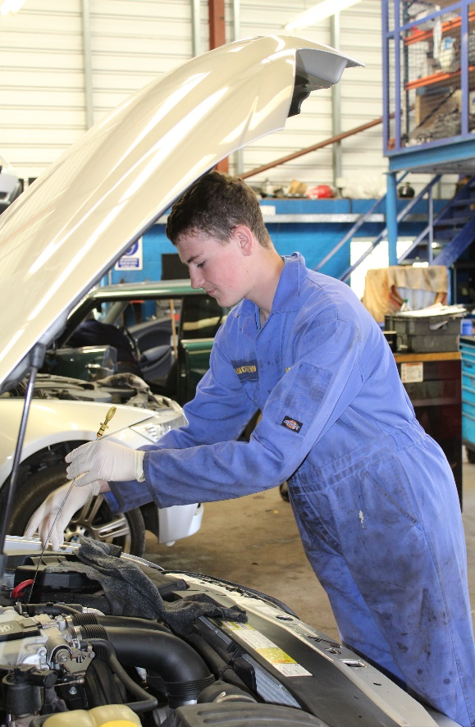
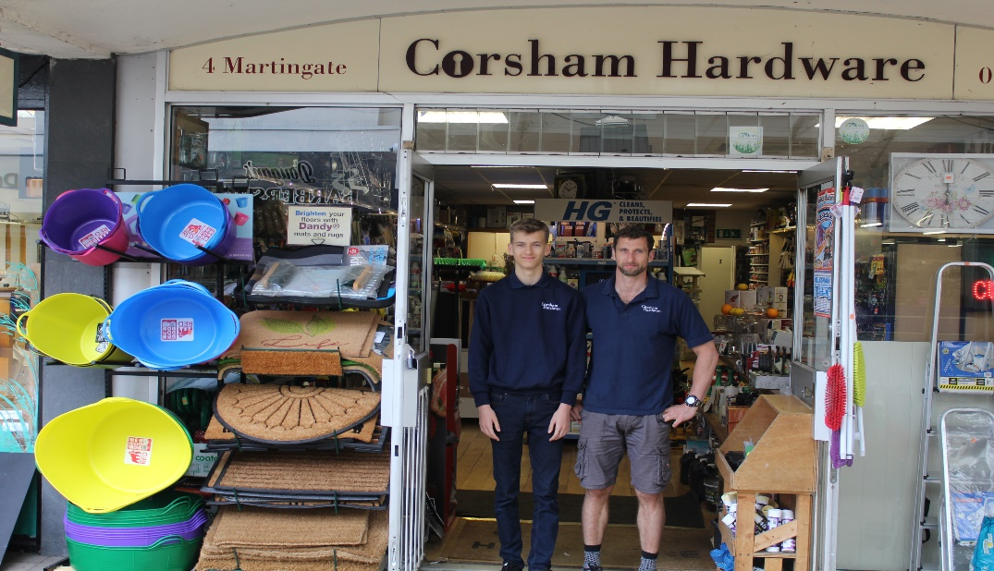
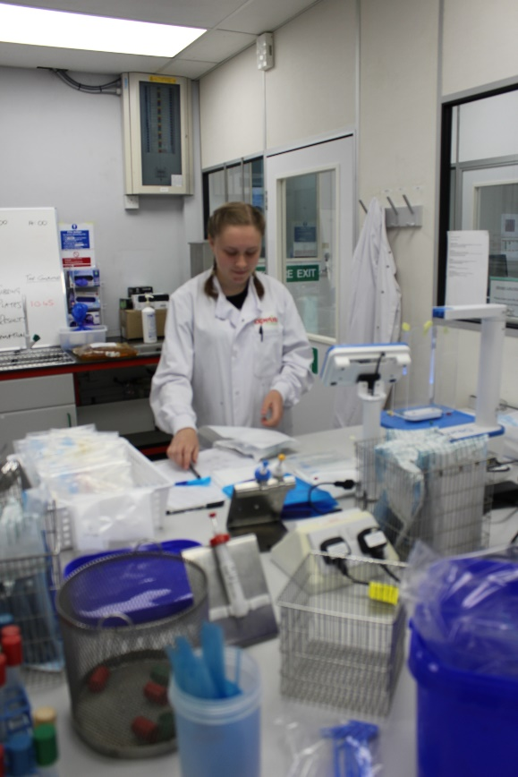
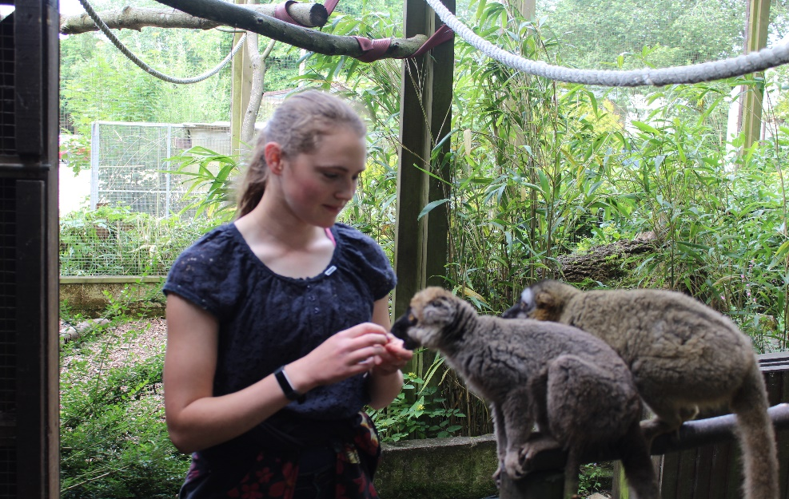
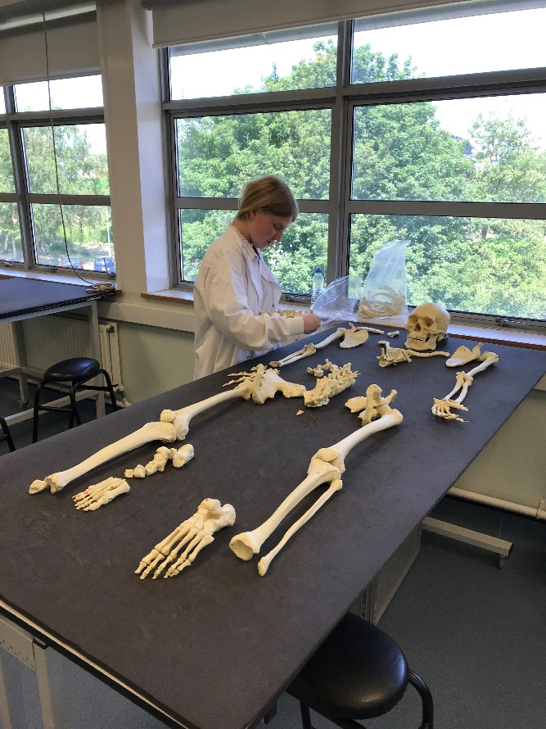

Slide 5
How?
You must arrange your work experience – it’s part of the ‘employability skills’ experience
But we can help you…… ☺

Slide 6
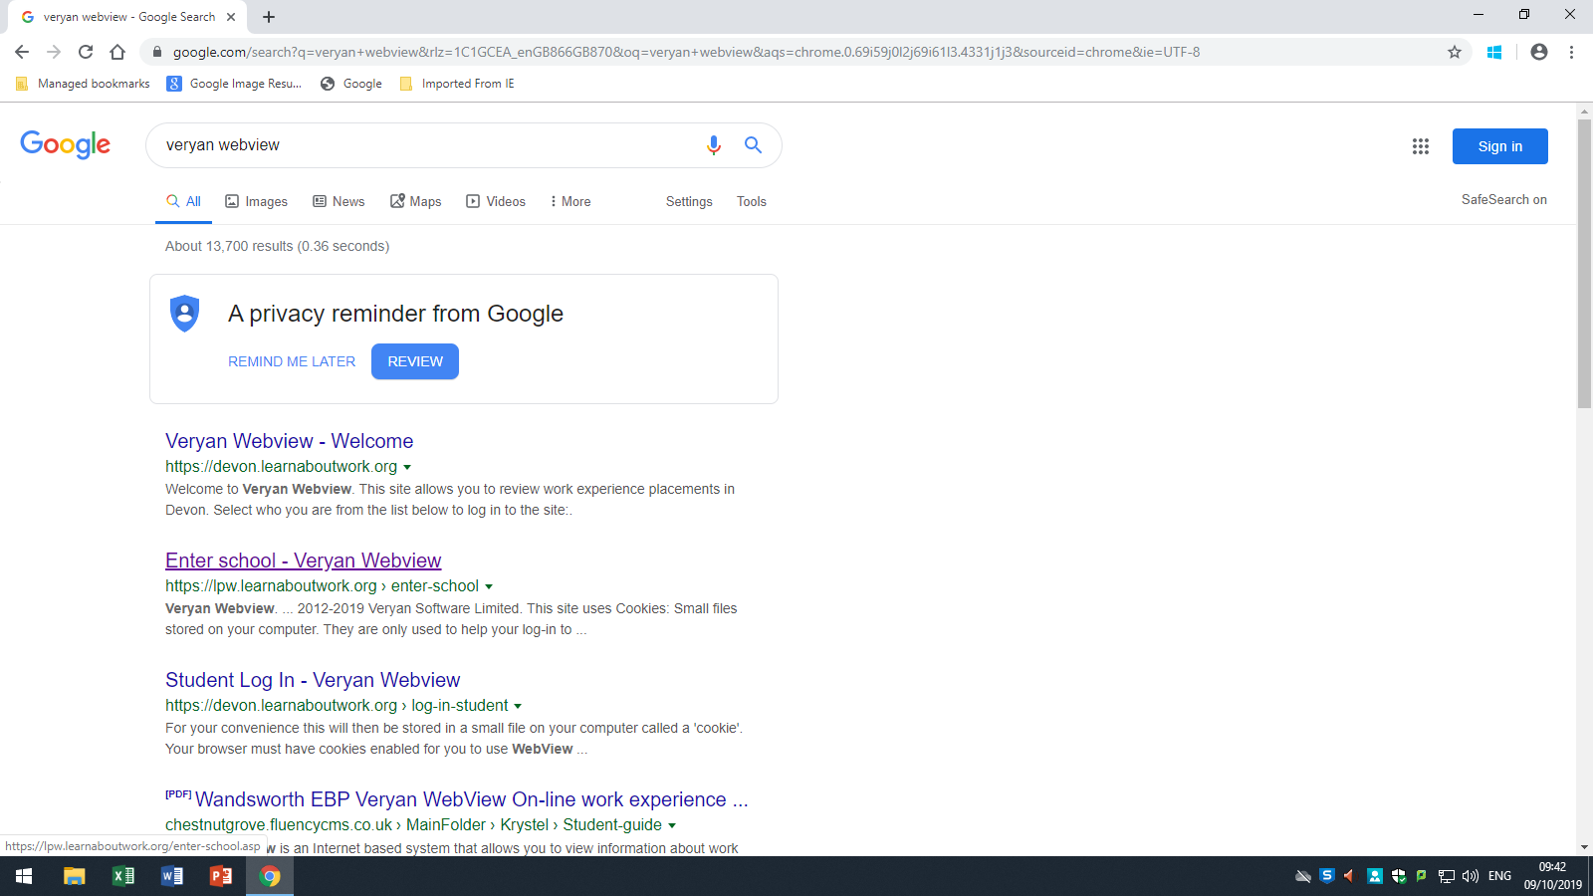
Click
‘Enter School’

Slide 7
Searching the Database

Slide 12
Your PSHE teachers will provide guidance on how to write a formal letter/email and make a formal telephone call to employers. You can also talk to your tutors, sixth formers in your tutor group or parents to proof read your letter for you.

Slide 13
Work Experience Agreement Form (Yellow Form)
Fill in your details
Ask your employer to fill in their details
You and your parents sign
Ask your employer to sign

Slide 15
Signed Work Experience Agreement Form and Health Declaration Form should be handed into the Careers Office in the ILC
by 12th February 2020

Slide 16
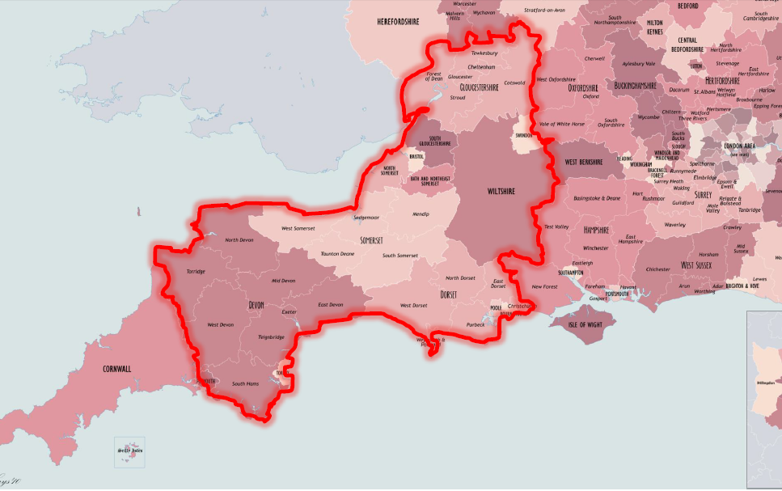
If you are intending to organise a placement outside of this geographical area, you must aim to get your form in before the deadline.

Slide 17
Put these dates into your diaries and phones.

Slide 18
Good luck! Please talk to us in Careers early if you experience difficulties – we are here to help!

